Slide 1
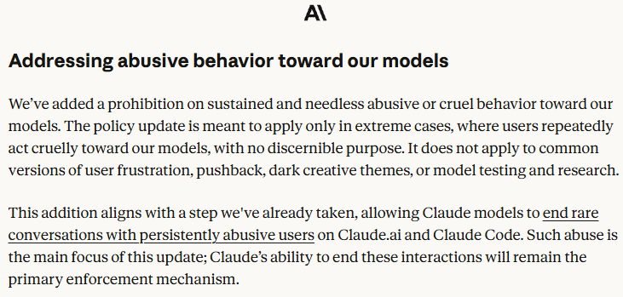
What Does It Mean to
Abuse an AI?
Luo Xiaoyu 21341457 Recorded video included: No
NEWS ARTICLE
Anthropic bans users from ‘needless abusive or cruel behavior’ towards Claude
2026 Usage Policy update
Publication date: 9 October 2026 Source: The Guardian
On 8 October 2026, San Francisco-based Anthropic announced an update to its online Usage Policy, effective 12 November, prohibiting “sustained and needless abusive or cruel behavior” toward Claude while excluding common user frustration, model testing and dark creative themes. Claude can already end rare, persistently harmful conversations. The policy directly affects Anthropic, users and developers. It matters because it treats possible harm to an AI as a wider ethical question, rather than only a private product rule.
View whole policy
For more information, click here.
If Claude’s moral status is uncertain, who should decide what counts as harm?
1 / 3
Notes:
Layout reference only. Replace all bracketed text with the student's own words.
Slide 1 must identify the event, source and stakeholders, and include the student's name, ID and recorded-video status.
Use The Guardian news report as the main article and Anthropic's official update as a supporting source.

Slide 2

Moral Status Under Uncertainty
STAKEHOLDERS
CONCEPT
Moral patienthood under uncertainty
Claude
Claude users, developers
Anthropic
The public
WHY IT MATTERS
Anthropic does not claim that Claude is conscious or can truly experience suffering; it frames the rule as a precaution against possible model-welfare risks.
Because defining and enforcing “harm” involves Anthropic, its safety team, users, developers, and external regulators, the policy raises a key question: how should responsibility be allocated across this chain? For example, responsibility should be distributed through a clear chain of ownership: Anthropic remains the accountable policy owner, its safety team enforces the rule, users and developers comply and implement it, and external regulators provide oversight.
The rule’s scope remains contestable: “It does not apply to common versions of user frustration, pushback, dark creative themes, or model testing and research.”
VALUE TENSION
Precaution for possible AI welfare and User freedom and transparent, contestable governance
2 / 3
Notes:
Layout reference only. Use one central ethical issue rather than a list of issues.
Connect the issue to a relevant course concept and explain the impact on different stakeholders.
Show the tension between two competing values so the audience can understand the trade-off.

Slide 3
MY POSITION / 03
01
WHY
[Give your strongest reason and evidence]
[State your position in one clear sentence]
02
COUNTERARGUMENT
[State the strongest alternative view, then respond]
03
RECOMMENDATION
[Name the actor and the specific action you recommend]
[One sentence explaining the ethical principle behind your position]
04
LIMIT
[Acknowledge a cost, limitation or unresolved uncertainty]
LAYOUT REFERENCE
3 / 3
Notes:
Layout reference only. The position, reasoning and recommendation must be written by the student.
Use this sequence: position, reason, counterargument, recommendation, limitation.
Keep the recommendation specific by naming both the responsible actor and the action.

